Slide 1
Correlations Between
Student Earnings & College Features
in US
Flora Tang & Owen Wang
Notes:
Hello everyone! My name is Flora, and this is Owen.(指)
Our project is about the correlations between student earnings and college features in US.

Slide 2
Motivation
Background: the median earnings of former students* is considered as an important indicator of college competency
Goal: help prospective students choose colleges based on features related to student earnings
* working and not enrolled 10 years after entry
Notes:
Nowadays, the median earnings of former students is considered as an important indicator of college competency.
So our goal here, is to help prospective students choose colleges based on features related to student earnings.
Notice that, in our project, "former students" refers to those who are working and not enrolled 10 years after entry.

Slide 3
Question 1
What are the yearly changes of median earnings of former students based on different college control types*?
* public, private nonprofit, private for-profit
Notes:
Our first question is: what are the yearly changes of median earnings of former students based on different college control types?

Slide 4
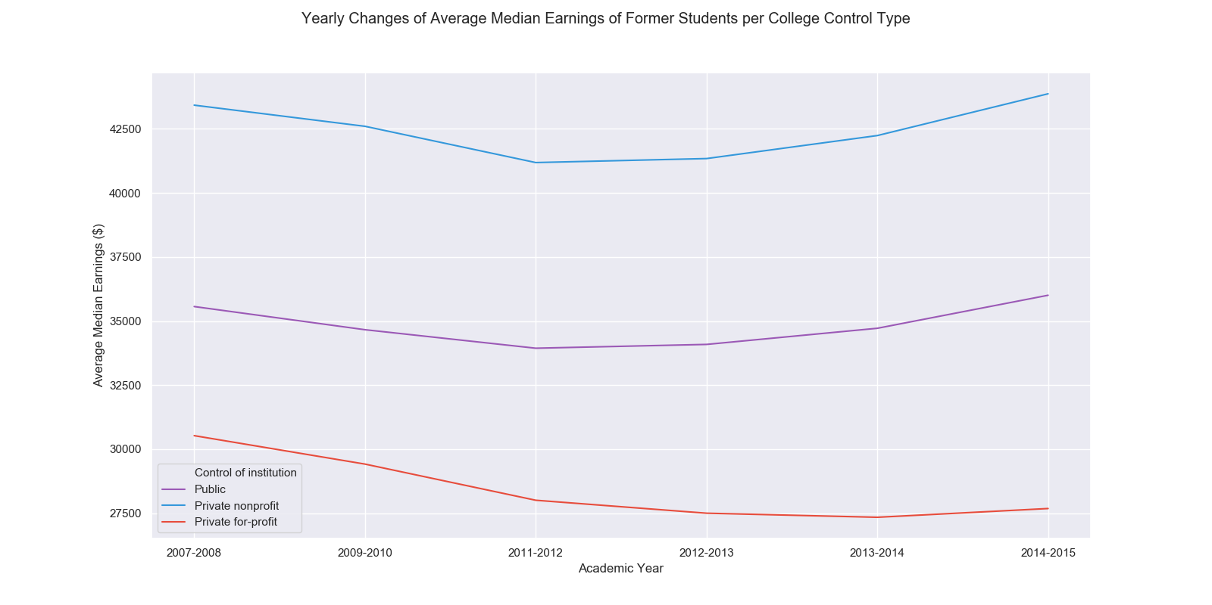
Notes:
As you can see here in the graph, control types ranking from highest median earnings to lowest is:(指) private nonprofit, public, and private for profit.
Also, during years, median earnings of private nonprofit and public are relatively constant, while median earnings of private for-profit was decreasing. (指)
So our suggestion here, is to choose private nonprofit and public instead of private for-profit.

Slide 5
Question 2
What are the median earnings of former college students in different states?
Notes:
Our second question is: what are the median earnings of former college students in different states?

Slide 6
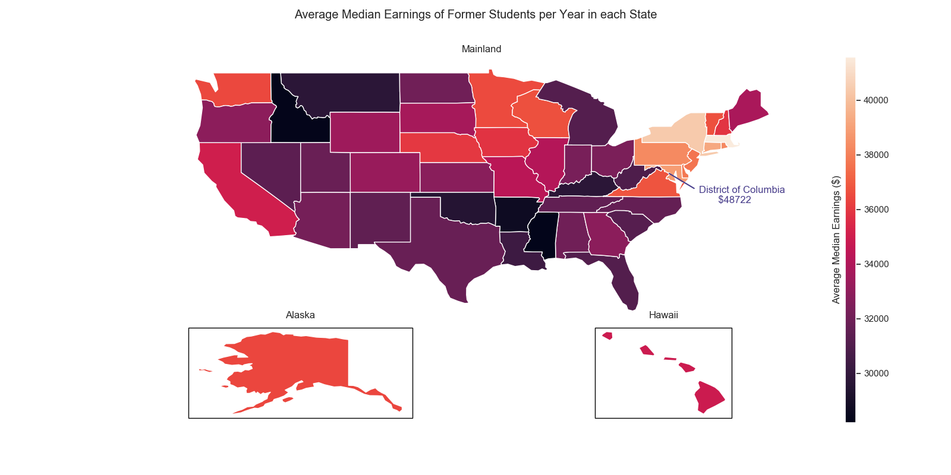
Notes:
According to the graph, the states with highest median earnings are:
District of Columbia, Massachusetts, New York, Connecticut, and Maryland. They are all here.(圈)
District of Columbia is an outlier, so we excluded it from the legend and labelled it on the graph.
This graph enables students to choose colleges based on states that correspond to their desired future earnings.

Slide 7
Question 3
What is the relationship between colleges’ median SAT and ACT score percentages* and median earnings of former students?
* actual credit / full credit
Notes:
Our last question is: what is the relationship between colleges’ median SAT and ACT score percentages and median earnings of former students?
Here the "score percentage" refers to the result of actual credit divided by full credit.

Slide 8
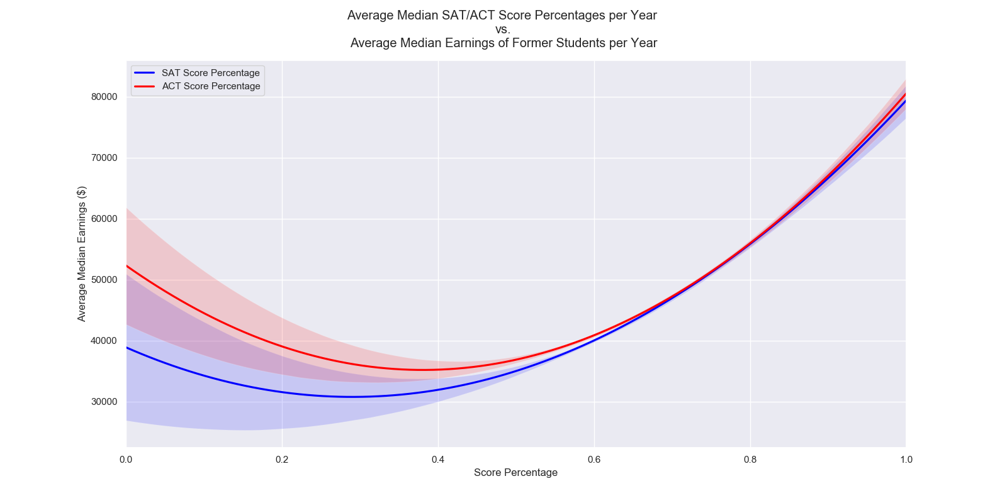
Notes:
The conclusion based on the graph is that, generally students should choose colleges with high score percentages (指), unless they are considering those at the lower end.(指)

Slide 9
Thank You!
Notes:
And that’s all. Thanks.

